Slide 1

Developing with the Brightcove Native Player SDK for iOS
Jeff Doktor
training@brightcove.com

Slide 2
Course Overview
In this course, you will create a Swift app in Xcode which uses the Brightcove Native Player SDK for iOS to play a video from your Video Cloud library

Slide 3
Course Outline
Introducing the course
Reviewing tools and resources
Understanding the Brightcove Native SDK for iOS
Tasks:
Creating a Swift project in Xcode
Importing the Native SDK for iOS
Setting the audio behavior for the app
Adding the playback controller to your app
Getting a video from your Video Cloud library
Connecting the Storyboard View
Managing media security
Running the app

Slide 4
Introducing the Course

Slide 5
Brightcove Native SDK
What is the Brightcove Native SDK for iOS?
A set of libraries built on top of the iOS native player framework
Takes advantage of speed, performance and flexibility of the native OS
Integrates with advertising, analytics, content protection (DRM) and captions
Enables you to configure and play Live and Live DVR content
Includes player controls that match the web player for consistency across desktop and devices

Slide 6
Users and Video Content
Who can use the Brightcove Native SDK for iOS?
It is available to anyone with a Video Cloud or Perform account
Where can you play video content from?
Video Cloud customers can play content from their Video Cloud library or from their own servers
Perform customers can play videos from their own servers
This course speaks directly to Video Cloud customers, but many concepts and code apply to Perform customers. Find Perform-specific code and steps in the Simple Video Playback guide

Slide 7
Audience and Prerequisites
Designed for developers or project managers who want to understand the capabilities of the Player SDK for iOS
Experience with Xcode along with the Objective-C and Swift languages will allow you optimally benefit from this course
Video Cloud account

Slide 8
Reviewing Tools and Resources

Slide 9
Tools
What tools do you need to use the Native SDK for iOS?
Xcode installed on your computer (Xcode 7 or later)
CocoaPods installed on your computer (version 0.39.0 or later)
Dependency manager that adds libraries to your project
Adds the Brightcove Native SDK for iOS and other needed libraries
CocoaPods is not required, but makes installation easier
CocoaPods site

Slide 10
Resources
Where do you find resources for the Native SDK for iOS?
Keynote slides can be downloaded from GitHub
Complete code and steps can be found in this Quick Start guide
A collection of code samples demonstrate specific use-cases
Use the SDK forum to submit questions and find answers from the community and Brightcove engineers

Slide 11
Understanding the Brightcove Native Player SDK for iOS

Slide 12
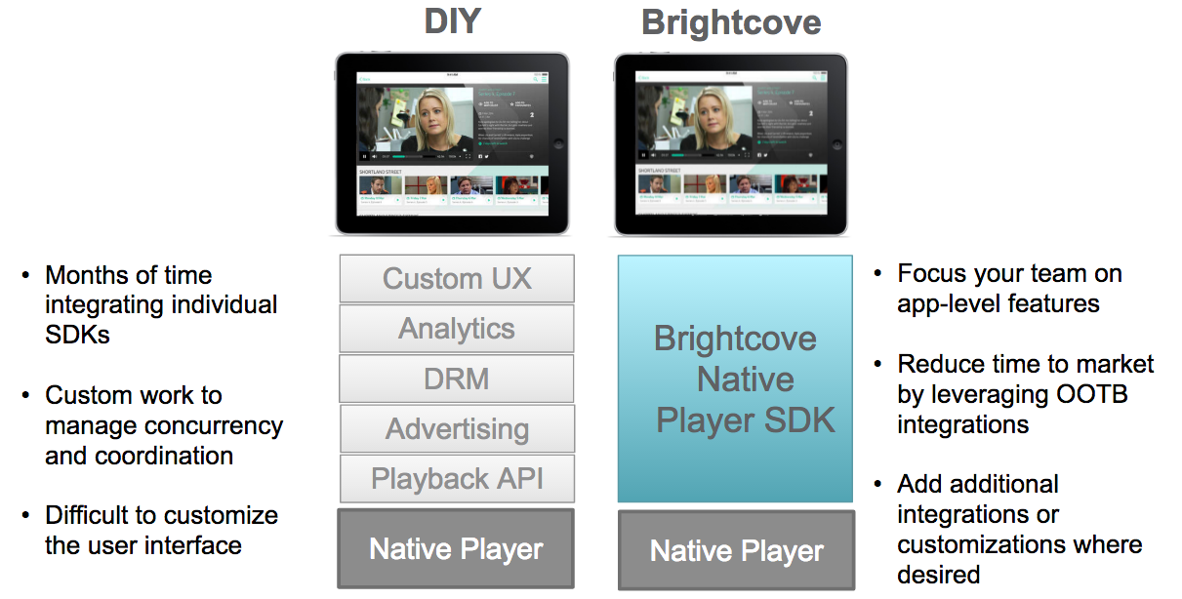
Brightcove Native SDK

Slide 13
The Brightcove Native SDK for iOS
Built on top of the iOS native player framework
AVFoundation
AVPlayer
Allows you to develop using Objective-C or Swift
Simplifies creating and customizing a native player
Easily integrates with advertising, analytics, captions, player UI controls and content protection (DRM)

Slide 14
Creating a Swift Project in Xcode

Slide 15
Setup an Xcode Project
Create a new Xcode project
Choose a Single View Application
Set the project information:
Product Name: Simple-Video-Playback
Organization Name: your company name
Company Identifier: com.yourcompany
Makes product name unique for the app store
Language: Swift (or Objective-C)
Devices: Universal
Leave Use Core Data unchecked
Used to persist data

Slide 16
Save Your Project
Choose a location on your computer where you want to save your project
Save it
Close your project
It is important to close your project out of Xcode if you choose to use CocoaPods to add library dependencies

Slide 17
Add Library Dependencies to Your Project
We will use CocoaPods to add the Brightcove Native SDK for iOS and other needed libraries to your project
In your project folder, create a plain text file, named Podfile
It has no file extension
Using a text editor, add the following to the Podfile:
The GitHub location for the Brightcove pod specs
The iOS platform version you want to target
The current version of the Brightcove Native SDK for iOS

Slide 18
Add Library Dependencies (cont.)
Open a Terminal session and navigate to your project folder
Type the following command:
pod install
This creates a .xcworkspace file in your project
From now on, you will always open and work from this new file in Xcode

Slide 19
Importing the Native SDK for iOS

Slide 20
Add a Bridging Header
Swift is compatible with Obj-C, and you can have both in the same project
Use a bridging header to import Obj-C code into your Swift project
Since the Brightcove Native SDK for iOS is written in Obj-C, you will use a bridging header in your Swift project

Slide 21
Add a Bridging Header - steps
Create a new header file for your project
In the new header file, import the BrightcovePlayerSDK
Point to this header file in your project Build Settings
Use the Objective-C Bridging Header property

Slide 22
Setting the Audio Behavior for your App

Slide 23
Set the Audio Session Category
The audio session handles audio behavior at the app level
Learn more about the AVAudioSession class
There are several audio session categories and settings to let you customize your app's audio behavior
Choose the best audio session category for your app
For this sample, you will use
AVAudioSessionCategoryPlayback
Plays audio even when the screen is locked and with the Ring/Silent switch set to silent

Slide 24
Set the Audio Session Category (cont.)
For simplicity, set the audio session category in the app delegate
Open the app delegate implementation file (AppDelegate.swift)
Import AVFoundation
Add code to set the audio session category

Slide 25
Adding the Playback Controller to your App

Slide 26
Build the View Controller Class
Open the view controller file (ViewController.swift)
Customize the project with your values
Your Video Cloud Account Id
Set the Playback controller delegate
Listen and respond to video playback events

Slide 27
Define Variables
Define a BCOVPlaybackController object
This class has methods to control playback functionality
Define a variable for the video view

Slide 28
Perform Initialization Tasks
Create an init() function that does the following:
Initialize a shared manager
The BCOVPlayerSDKManager class is a singleton that allows you to create other objects in the SDK ecosystem
Using the shared manager, create a playback controller with the default view strategy
Send your Account Id to Video Cloud Analytics
This is optional, and only needed if you do not get your video content from either Brightcove's Playback API or Media API

Slide 29
Perform Initialization Tasks (cont.)
Set the Playback Controller's delegate to self.
This means that the view controller will be notified when tasks are completed
Turn on autoAdvance and autoPlay features for the player

Slide 30
Configure the Player
Configure the player once the view has been loaded
Set the player size to that of the view container
Set the player to automatically resize as the view resizes
Add the player view as a subview of the main view
Call a function to request a video from your Video Cloud library
We'll create this function next

Slide 31
Getting a Video from your Video Cloud Library

Slide 32
Customize the project with your values
Below the import directives, add the following values
Your Brightcove Playback API Policy Key
Either get the Policy Key from a player in your account as shown in the Policy Keys guide
Or create a Policy Key by following the steps in the Quick Start to the Policy API document
Your Video Cloud Video Id

Slide 33
Define Variables
Create an instance variable from the BCOVPlaybackService class based on your Video Cloud Account Id and Policy Key
This class provides asynchronous methods for retrieving data from the Playback API

Slide 34
Request a Video from your Video Cloud Library
Using the Video Id, retrieve a video from the Playback API
If a video is returned, add it to the player
Otherwise, display an error message

Slide 35
Connecting the Storyboard View

Slide 36
Connect the Storyboard View
Select the Main.storyboard
In the assistant editor, open the ViewController.swift file
Connect the videoContainerView variable with the View Controller View in the storyboard

Slide 37
Managing Media Security

Slide 38
Understand App Transport Security
App Transport Security (ATS) enforces secure connections between your app and web services
This feature was added with the release of iOS9 SDK - Only an issue if your app targets the iOS9 SDK or later
You can either:
Build your app with ATS enabled
You must use https to deliver your media content
Disable ATS requirements
You can use http to deliver your media content
For details, see the Working with ATS document

Slide 39
Running the App

Slide 40
Run the app
The app is ready to build and run on your iPhone, iPad or Xcode Simulator
You should see a video play from your Video Cloud library

Slide 41
Quick Start Resources
You've built one version of this app, but there are others available
Video Cloud customers
The complete Swift code is in the Swift Quick Start guide
The complete Obj-C code is in the Obj-C Quick Start guide
Perform customers
The complete Swift code is in the Swift Quick Start guide
The complete Obj-C code is in the Obj-C Quick Start guide

Slide 42
Additional Resources

Slide 43
Samples using the Native Player SDK for iOS
Basic code samples for feature integration
http://docs.brightcove.com/en/video-cloud/mobile-sdks/brightcove-player-sdk-for-ios/index.html#Integrations
Complete list of code samples
https://github.com/BrightcoveOS/ios-player-samples

Slide 44
Online Training and Quick Start Guide
Video Cloud Training On-Demand Courses
http://ondemand.brightcovelearning.com
Quick Start to Video Cloud
Set of hands on steps you can work through on your own to discover some of the features of Video Cloud
http://support.brightcove.com/en/video-cloud/docs/quick-start-video-cloud

Slide 45
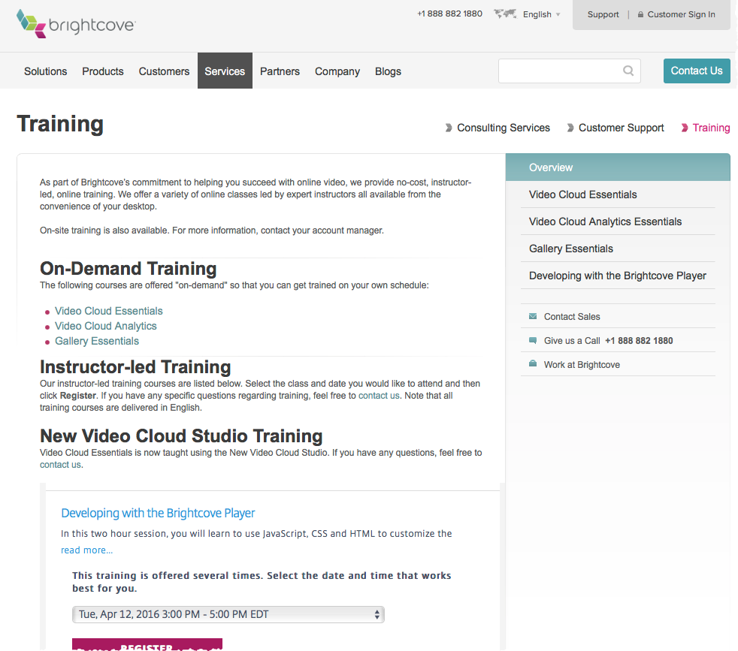
Additional Training Courses
Brightcove.com > Services > Training

Slide 46
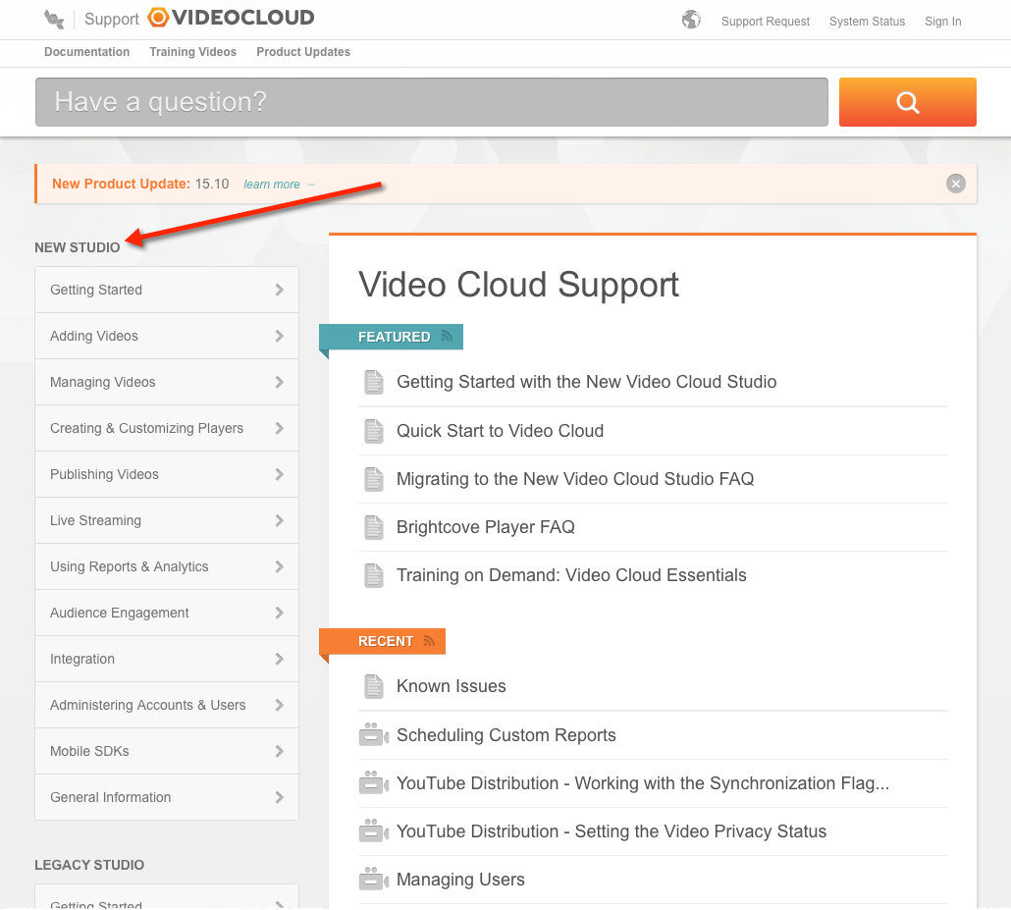
User Documentation
support.brightcove.com

Slide 47
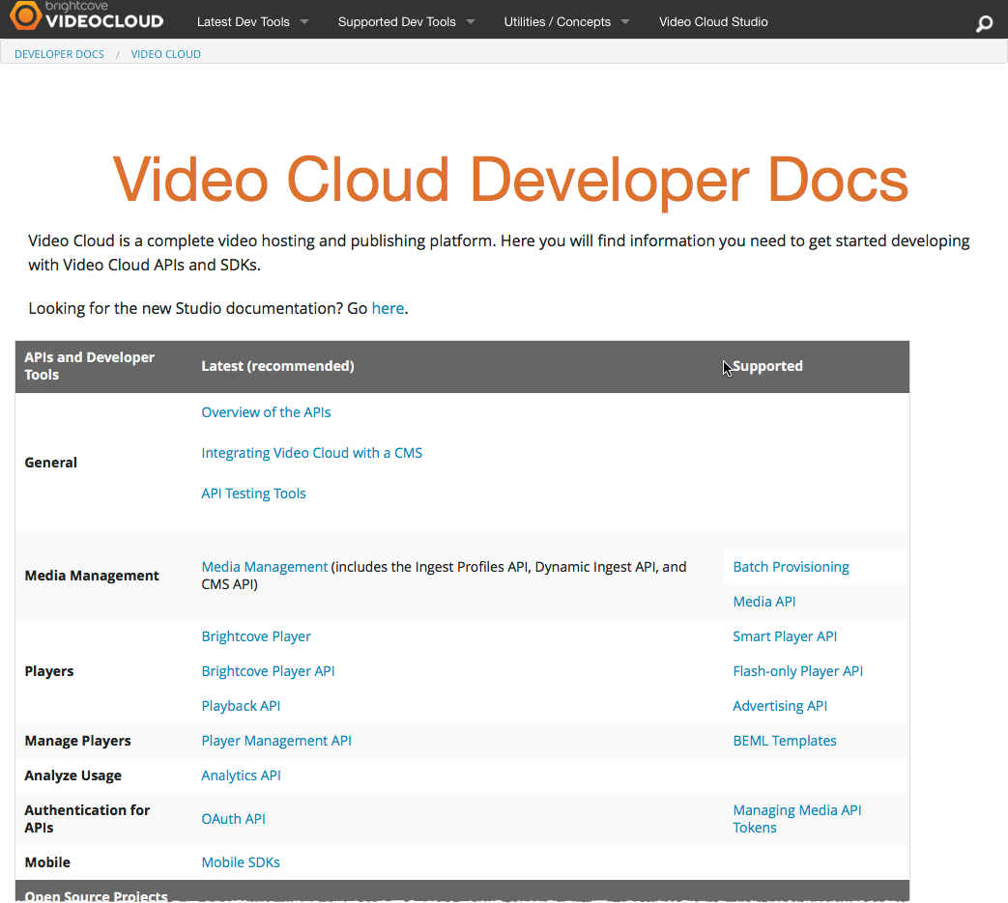
Developer Documentation
docs.brightcove.com

Slide 48
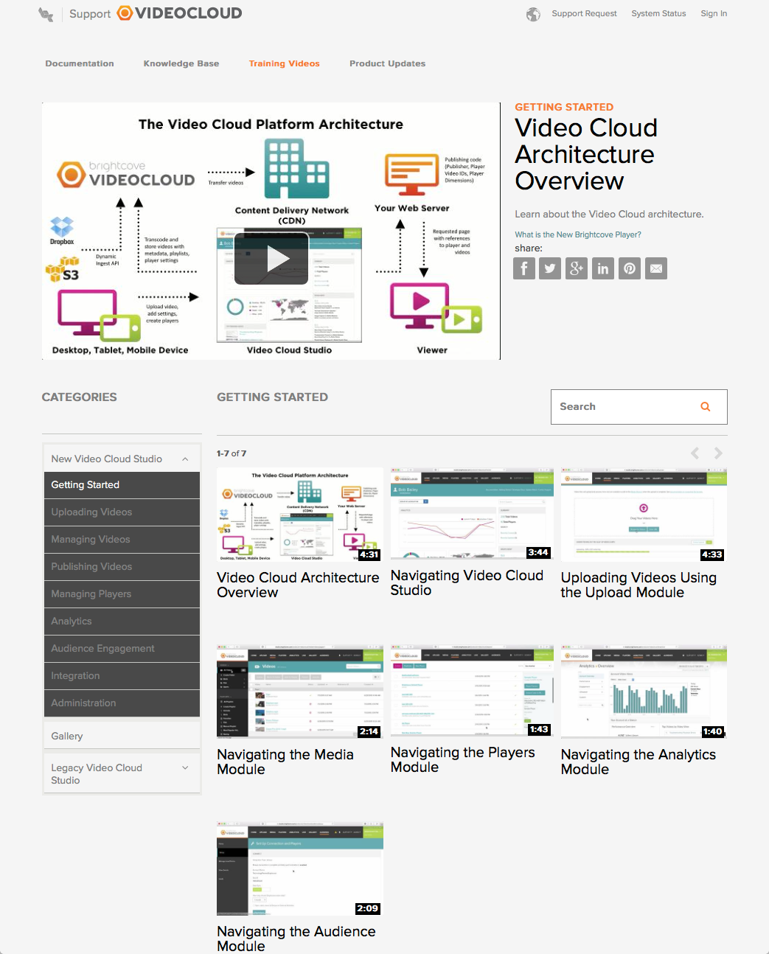
Training Videos
video.brightcovelearning.com

Slide 49
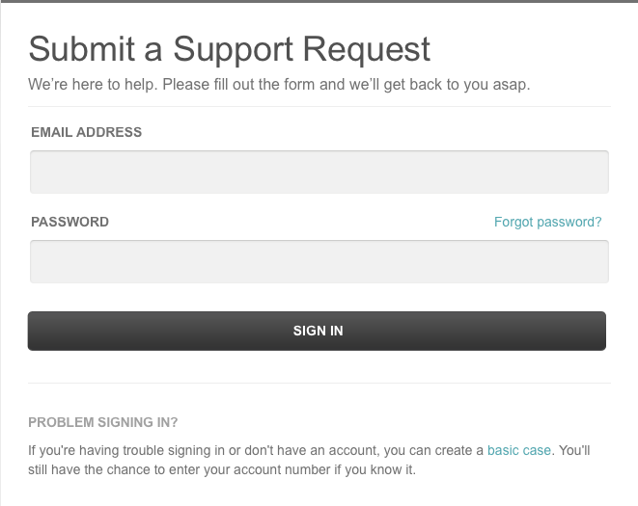
Support Request
http://support.brightcove.com/en/contact

